Slide 1
Lesson 11 – Homework review

Slide 2
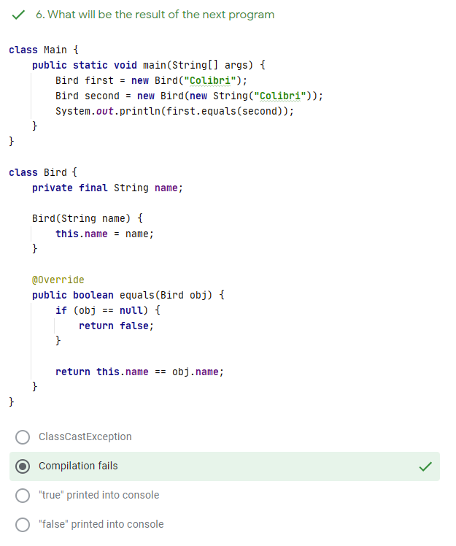
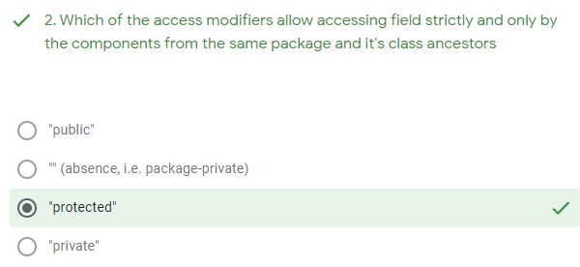
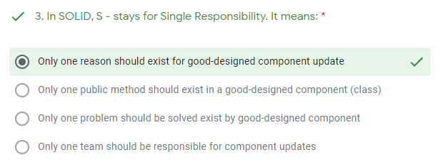
Test results

Slide 3
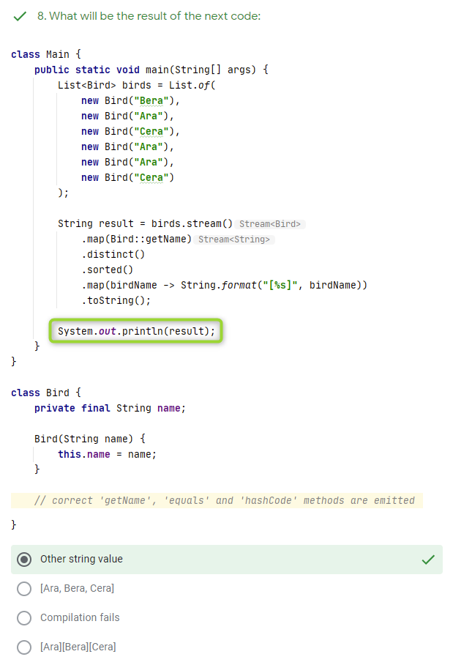
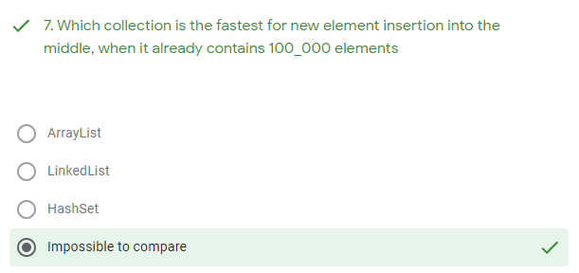
Test results

Slide 4
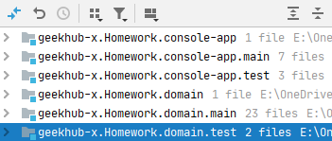
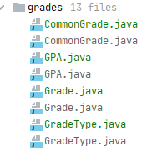
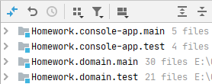
1. Atomic commits are not bad. 2. History matters

Slide 5
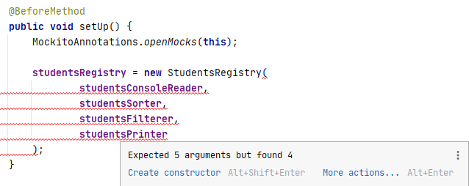

Unit tests matters

Slide 6

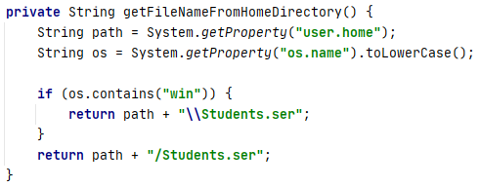

Use NIO2 API

Slide 7


Prevent ClassCastException

Slide 8


Process checked exceptions

Slide 9

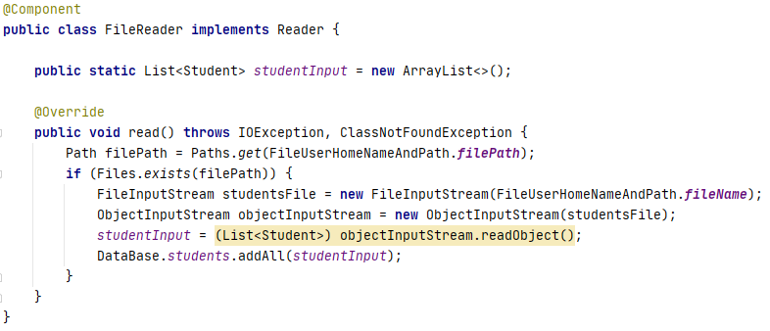
Keep services stateless

Slide 10
Thanks!
Any Questions?
Or find us in Slack:
@Yaroslav Brahinets
@Vasya Rudas

